Slide 1
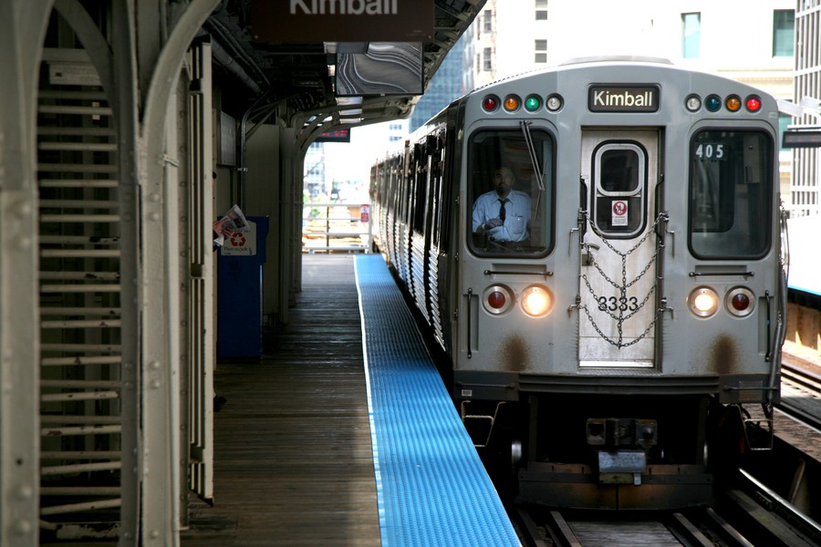
GROUP 6 | CTA CRIME ANALYSIS

Slide 2
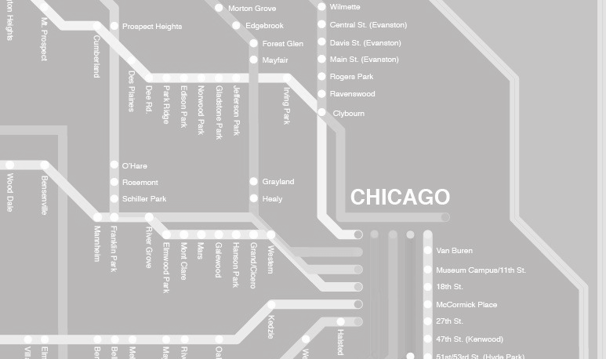
TABLE OF CONTENTS
Executive Summary
Business Case
Data Sources
Additional Considerations
Tools

Slide 3
EXECUTIVE SUMMARY
Crime on public transportation and in its surroundings is severe in Chicago, posing a threat to consumers and a challenge to law enforcement authorities
Many of the UChicago students are frequently using public transportation and hence affected by this issue
The objective of this project is to discover patterns in the occurrence of crime on and around public transportation
The insights derived will be used:
To give consumers guidance on the risk related to taking the route that they are anticipating to take
To help authorities understand what factors contribute to spikes in crime and give recommendations on how to provide more safety on public transportation

Slide 4
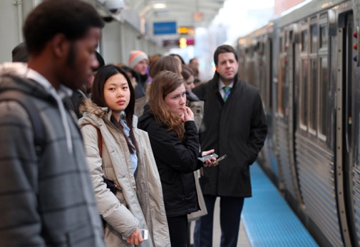
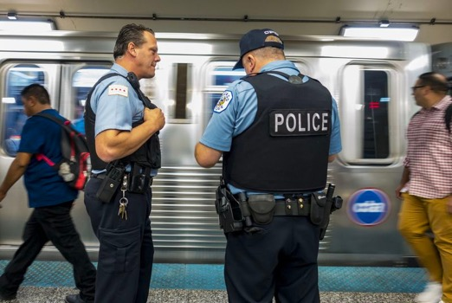
TARGET GROUPS
CONSUMER
AUTHORITIES
Any person using public transportation in Chicago, including commuters, residents and tourists
Any organization responsible for providing safety on public transportation in Chicago e.g. CPD, private security
Notes:
<Insert Demographics>
<Insert Psychographics>
Age/Lifestyle/Occupation/Income

Slide 5


PAIN POINTS
Exposed to crime on public transportation
Lack of information on the safety of taking public transportation
Avoiding dangerous routes as a tourist
Trade off between safety and cost for transportation
Lack of safer options
Chicago’s reputation as one of the most dangerous cities in the US
Inability to ensure safety and prevent crime on public transportation
Lack of information on how external factors influence crime on public transportation
Lack of information on where to increase staffing and presence.
CONSUMER
AUTHORITIES
Notes:
<Insert Demographics>
<Insert Psychographics>
Age/Lifestyle/Occupation/Income

Slide 6
SOLUTION AND IMPACT
Provide insights into the risk level of using a given means of public transportation at a given point in time
Provide greater transparency on the safety of different public transport options
Provide insights into how to increase safety on public transportation by unveiling dominant crime patterns
Provide predictive information on when to anticipate heightened crime, and help improve staffing efficiency
CONSUMER
AUTHORITIES
Notes:
<Insert Demographics>
<Insert Psychographics>
Age/Lifestyle/Occupation/Income

Slide 7




DATA SOURCES
Chicago crime reports
Location descriptions
Geocodes
CTA routes
CTA ridership statistics
Weather
Events
U.S. Office of Personnel Management

Slide 8
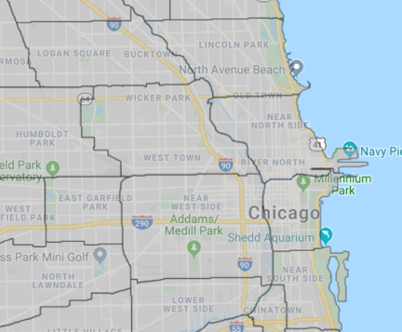
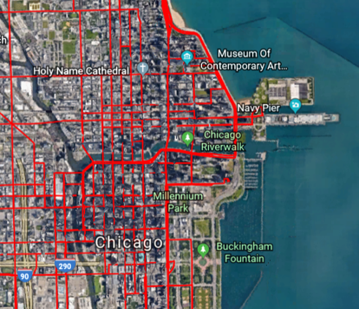
METHODOLOGY
Match crime geocodes to districts
Divide each CTA route into districts passed through
Use crime statistics by district to weigh risk on routes and at stops

Slide 9




TOOLS
Used for Data Extraction, Data Preparation and Data Analysis
Used for Data Storage
Used for Data Visualization
Used for Data Normalization, Database Design and Data Manipulation

